Slide 1
Data Scientist - Case Study
Suvro Banerjee, 09/07/2015

Slide 2
Topics Covered
Problem Statement
Understanding the data set
Data Pre-processing , Plotting & Analysis
Fitting Statistical Models
Conclusion

Slide 3
Problem Statement

Slide 4
Problem Statement
Manheim, an automobile auction company wants to understand the main factors that can make dealer sales conversion rate better for a specific location.
From their location one-year sales transaction data they want to know which of the following statements are TRUE for their location and how they can be ordered in terms of degree of impact so that they can better organize their sale process.

Slide 5
Questions
Older model year cars are not selling well than newer model year cars.
Having condition report helps to sell the car.
To sell your car, you need to get a better run numbers.
Less chance to sell a car towards end of a long sale.
Setting a floor price helps selling a car.
Bad seller reputation has negative impact to seller’s conversion rate.

Slide 6
Understanding the data set

Slide 7
Data set
Every record is a dealer sale registration.
The original data set has 53,836 rows and 28 columns (1 year sales transaction data for a specific location.)
The response variable is DMSOLD which is “Y” when the car is sold, else “N”.
The data set has a mix of Quantitative and Qualitative variables.
The distribution of the response variable (DMSOLD) between the classes “Y” and “N” is evenly distributed.

Slide 8
Data Pre-processing, Plotting & Analysis

Slide 9
DMSTDESL
Description | Sale Date
Original Data Type | Integer
Converted Data Type | Date (POSIXct)
Range | Min : 2013-01-02 Max : 2013-12-18
“NA” values | No

Slide 10
DMMONTH , DMSALWK
Description | Sale Month
Original Data Type | Integer
Values | 1, 2, … 11, 12
Description | Sale Week
Original Data Type | Integer
Values | 1, 2, … 50, 51

Slide 11
SSALE_ , SLANE_
Description | Sale #, given by auction for a particular sale
Original Data Type | Integer
Values | 1, 2, … 50, 51 (same as DMSALWK)
Description | Lane #, that the vehicle is on sale
Original Data Type | Integer
Values | 3, 4, … , 11, 12

Slide 12
SRUN_
Description | Run #, that the vehicle was given (based on how many times it run on the lane )
Original Data Type | Integer
Values | 1, 2, … 999
“NA” values | No
Mean Value | 265

Slide 13
STIMES
Description | Run Time is the time the vehicle runs through the lane
Original Data Type | Integer
Values | 173200 which means (17:32:00 i.e. 17 hrs 32 mnts & 0 sec)
New Columns created | STIMES_SEC (records the Run Time in seconds) STIMES_H (records the Run Time in hours)
Unclean data | 0, means the data is not properly recorded (which will be cleaned)

Slide 14
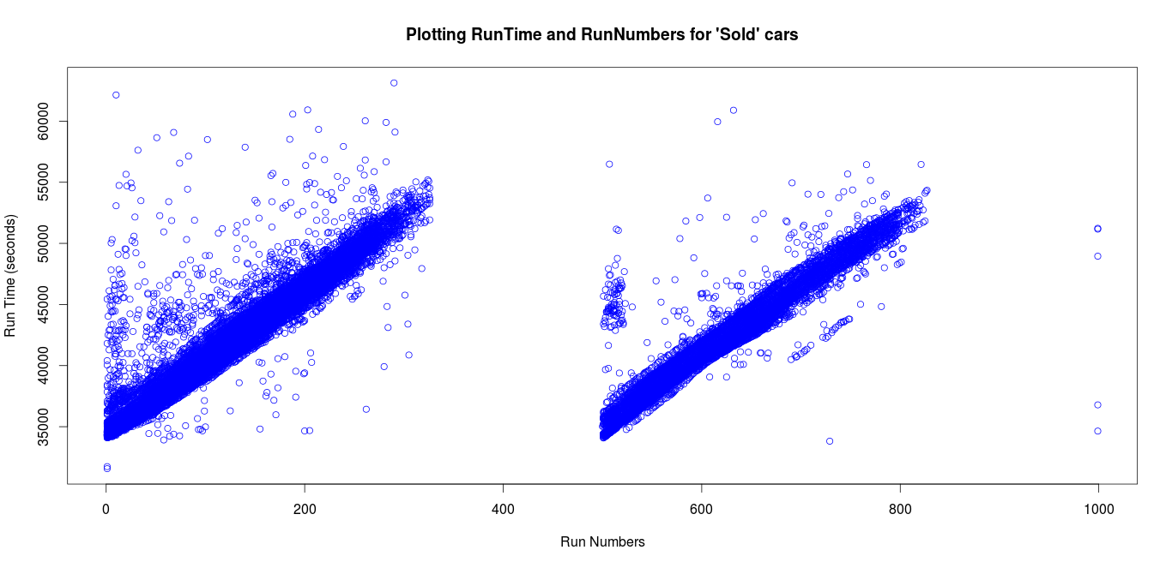
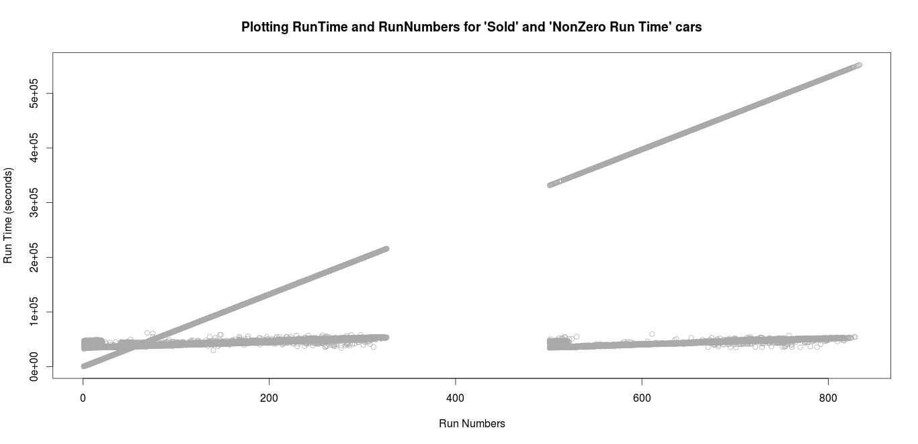
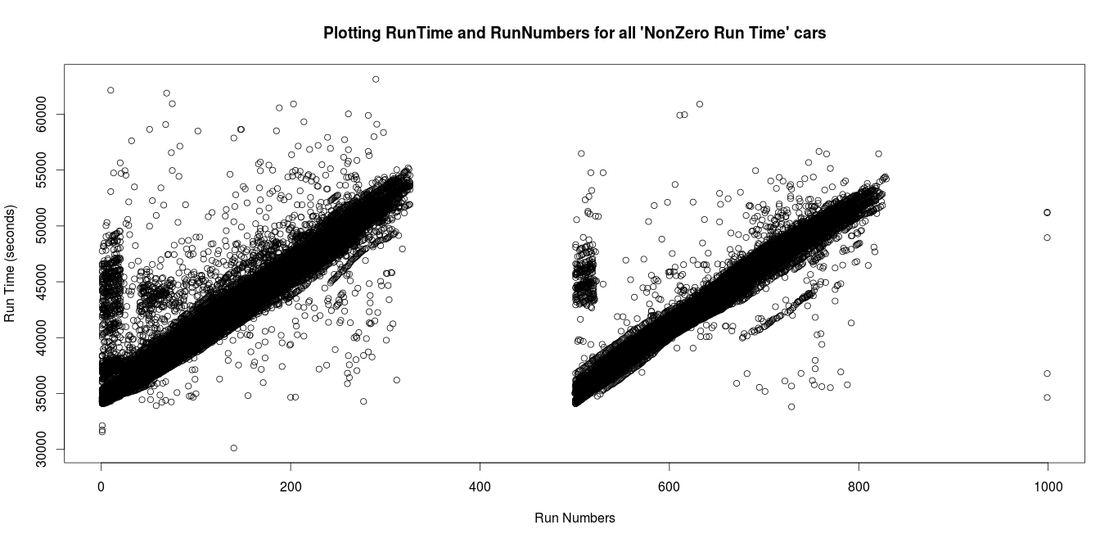
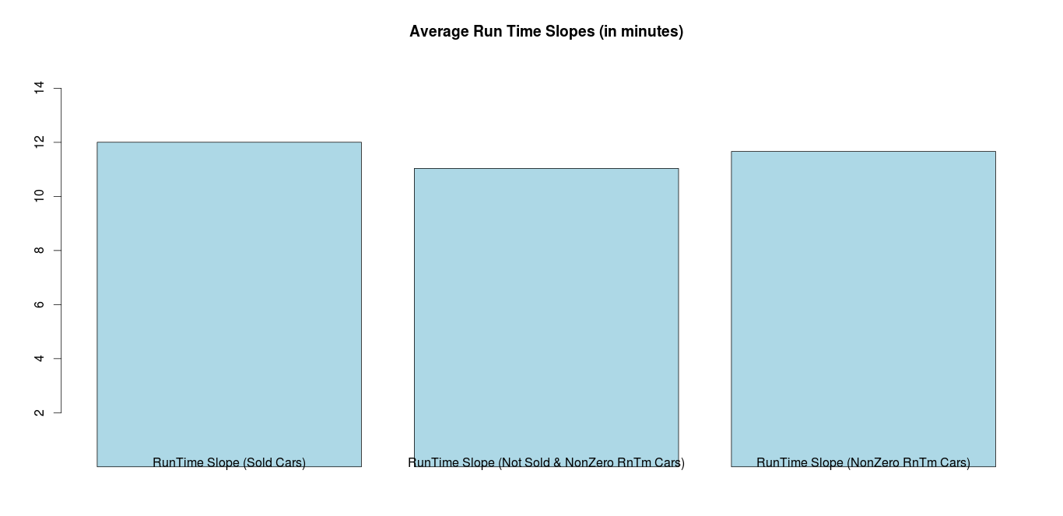
Relation b/w Run Time & Run Numbers

Slide 15
STIMES (cleaning for 0 values)
Run Time increases as Run Number increases (based on the plots)
Find the relation (slope) between Run Time & Run Number for each class.
 | Average Run time per Run Number (in secs)
SOLD | 720.2471 (12 minutes)
UNSOLD | 662.0829 (11 minutes)
All SOLD & UNSOLD | 699.8412 (11.6 minutes)
Note: Zero Run Time only exists in Not Sold cars (seen from the data),
so populated them based on the slope of the UNSOLD class,
i.e. Run time = Run Numbers * 662.0829

Slide 16
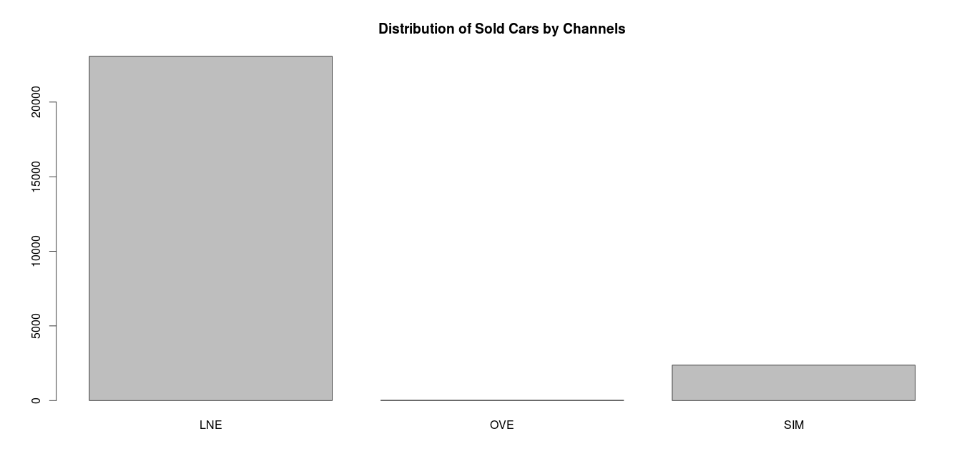
DMTRANTYPE
Description | Purchasing Channel
Original Data Type | Factor
Blank Values | Yes, converted to “NA”s
Values | "" "LNE" "OVE" "SIM"

Slide 17
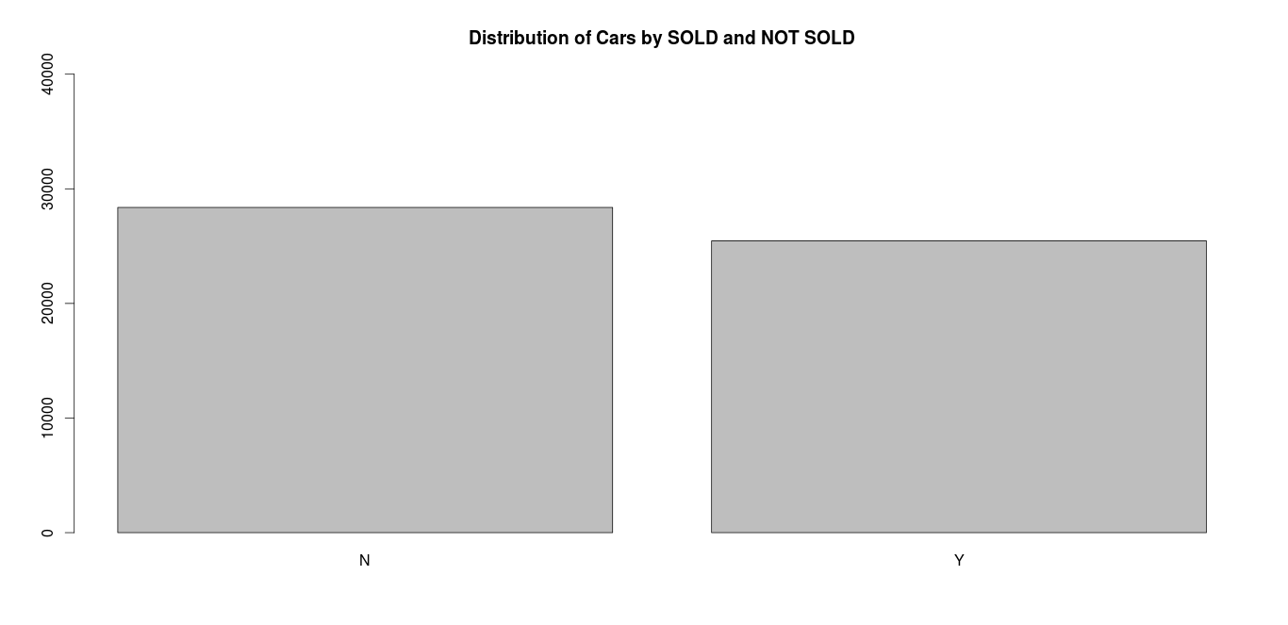
DMSOLD, DMOPCSUID, DMSELLRNM
Description | Sold (Y/N) : Response Variable
Original Data Type | Factor
Values | 1, 2, … 11, 12

Slide 18
DMOPCSUID, DMSELLRNM
Description | Seller ID
Original Data Type | Integer
Values | 4900557, 4907812 ,4908299, ...
Description | Seller Name
Original Data Type | Factor
Values | PMORGAN CHASE BANK, N.A. MANHEIM HOUSTON ...

Slide 19
SFLOOR
Description | Floor Price (The seller's asking price for a vehicle, buyers would not know)
Original Data Type | Integer
Values | 4900557, 4907812 ,4908299, ...

Slide 20
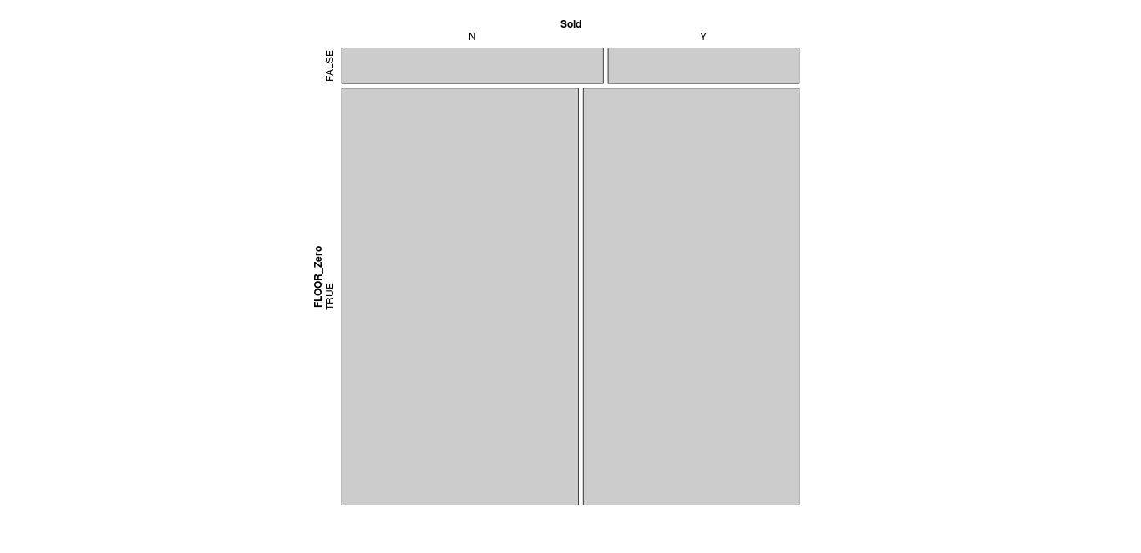
Plotting the distribution
7.84 % cars which has FLOOR values
92.16 % cars which has NO FLOOR values
The height of the mosaic plot shows this distribution.

Slide 21
Conditional distribution (by Floor)
Given FLOOR = 0 (NO Floor) :
52.27 % cars NOT SOLD
47.73 % cars SOLD
When a seller doesn't provide a floor value then there is almost an equal distribution between SOLD and NOT SOLD classes.
Reason might be there is a less friction between the Buyer and Seller transactions.

Slide 22
Conditional distribution (by Floor)
Given Floor != 0 (YES Floor) :
57.78 % cars NOT SOLD
42.22 % cars are SOLD
When a seller provides a floor value then the distribution between both the classes are not equal. There are more cars NOT SOLD.
This might be because the Floor price is not reasonable and not been in sync with the Wholesale price guide MMR values.

Slide 23
VNMMR
Description | Manheim Marketing Report (MMR: National Average whole sale price for the particular vehicle)
Original Data Type | Integer
“NA” values | Yes, updated all “NA” values to 0
Assumption : VNMMR might be used as a reference to set the FLOOR price by the sellers.
Let's analyze FLOOR just on the basis of VNMMR price.

Slide 24
A new variable created
Name | Floor_VNMMR
Data Type | Factor
Values | NotApplicable, NotConsulted, High, Low
This variable will have the values based on FLOOR and VNMMR prices based on the following analogy.
Floor | VNMMR | Floor_VNMMR
0 | 0 | NotApplicable
100 ... | 0 | NotConsulted
200 ... | 100 ... | High
300 ... | 300 ... | Equal
400 ... | 600 ... | Low

Slide 25
Conditional distribution of Floor_VNMMR
 | Floor_VNMMR
DMSOLD | Equal | High | Low | NotApplicable | NotConsulted
N | 56 % | 61 % | 51 % | 52 % | 68 %
Y | 44 % | 39 % | 49 % | 48 % | 32 %
When spread is equal, then about the same distribution between two classes.
When FLOOR > VNMMR, more number of NOT SOLD.
When FLOOR < VNMMR, then same distribution.
When both the prices were missing, then same distribution.
When FLOOR price was not consulted, then more NOT SOLD.

Slide 26
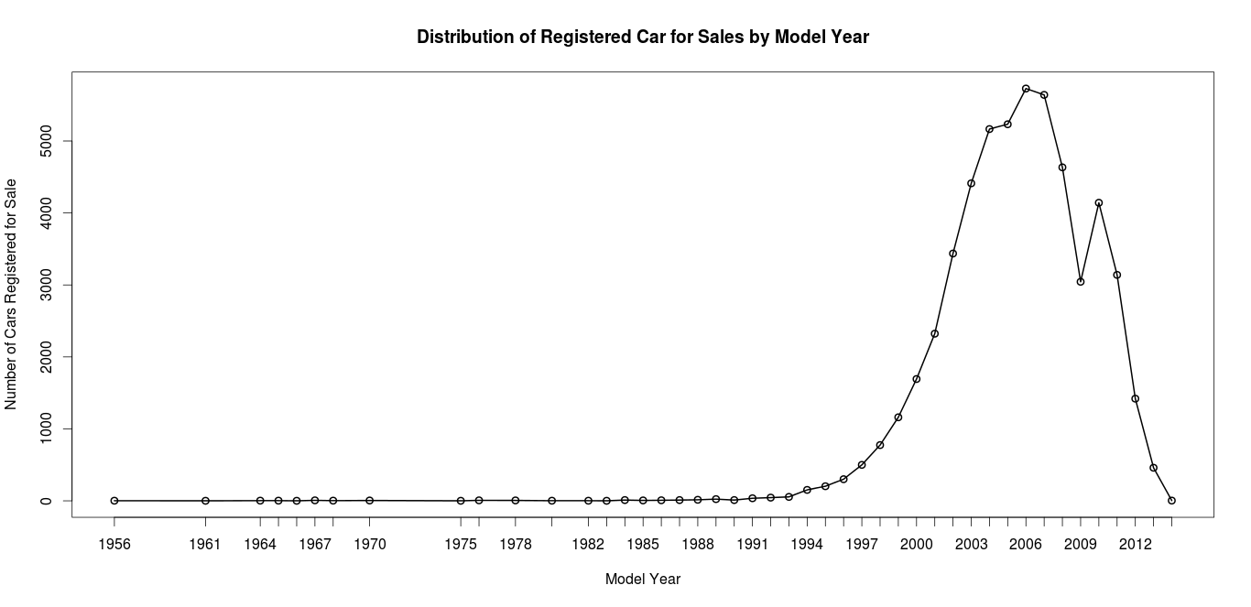
DMMODELYR
Description | Vehicle Model Year
Original Data Type | Integer

Slide 27
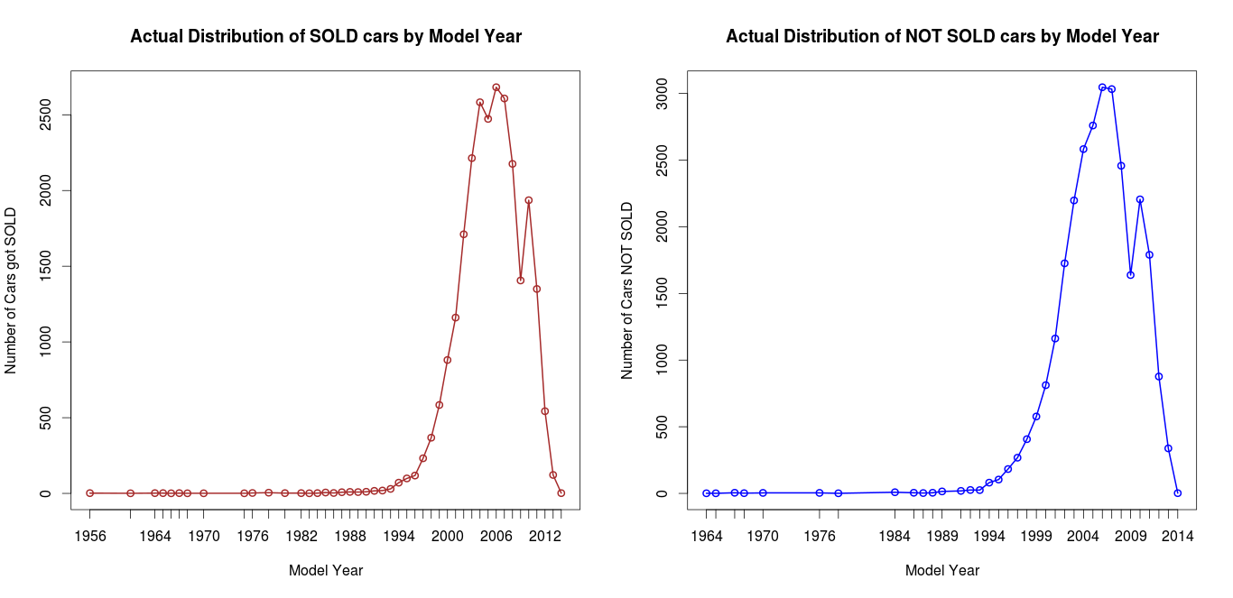
Conditional distribution (Actual values)
Note: Using the ACTUAL values it is not conclusive if Model Year affects the Sold / Not Sold. Let’s use
Now we’ll use the Percentage of cars sold by Model Year.

Slide 28
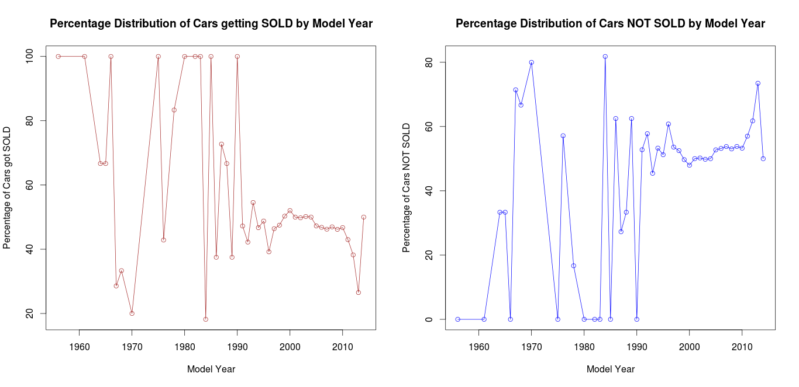
Conditional Distribution (Percentage values)
Even using percentage of cars did not give a conclusive result. So, let’s bin it now.

Slide 29
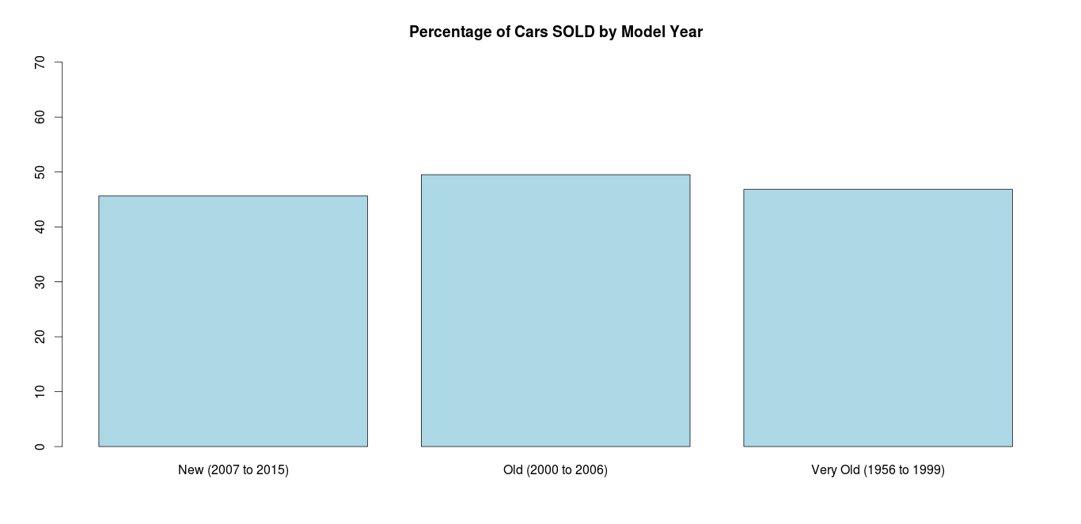
Creating a new variable ModelYear_P
Binning the Model year based on the following values and create ModelYear_P
1956 to 1999 | VeryOld
2000 to 2006 | Old
2007 to 2015 | New
Based on the Model Year the distribution of SOLD cars are about the same.

Slide 30
DMMAKE, DMMODEL
Description | Vehicle Make
Original Data Type | Factor
Values | SUBARU ,B M W, NISSAN ,NISSAN ,RAM ...
Description | Vehicle Model
Original Data Type | Factor
Values | OUTBACK 4C, X SERIES, ALTIMA 4C ...

Slide 31
DMBODY, SSER17, SSLEPR
Description | Vehicle Body
Original Data Type | Factor
Values | 4D WAGON 2.5I, X5 3.0SI SPORT ACTIVITY VEHICLE
Description | Vin #
Original Data Type | Factor
Values | 4S4BRBAC9A3355912 (not unique)
Description | Sale Price
Original Data Type | Integer
Values | 0, 18500 , 5000

Slide 32
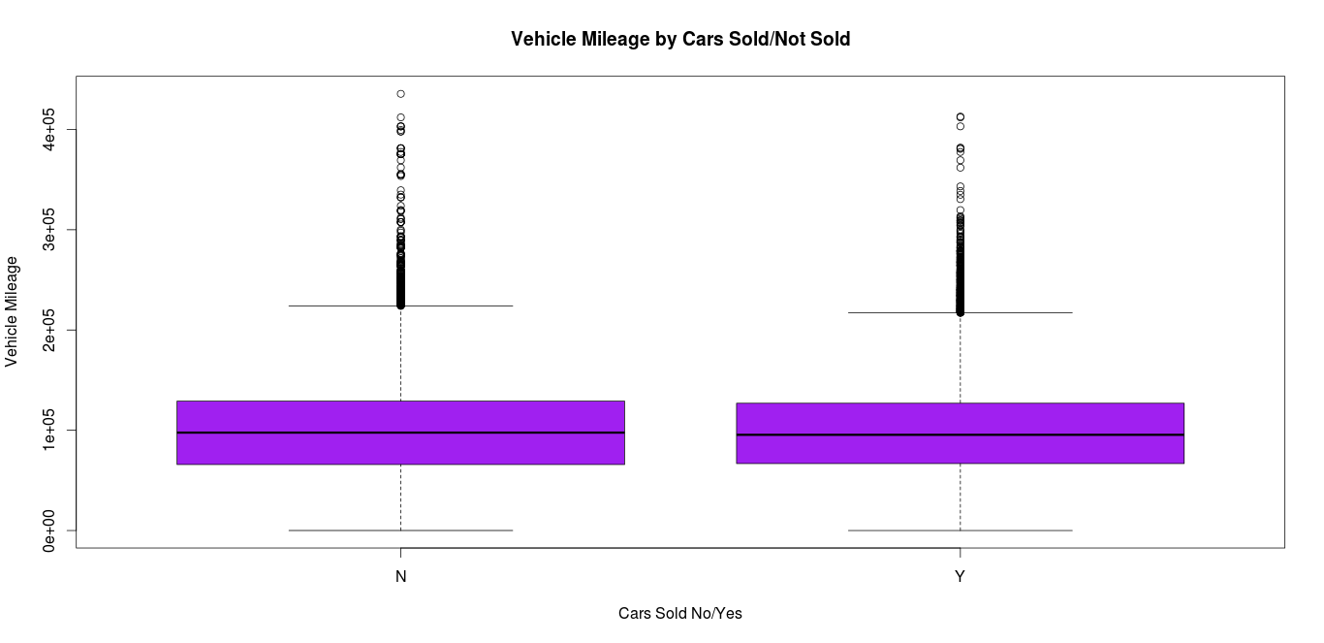
SMILES
Description | Vehicle Mileage
Original Data Type | Integer
Values | 4D WAGON 2.5I, X5 3.0SI SPORT ACTIVITY VEHICLE
The distribution is almost same.

Slide 33
DMJDCAT , AGEDDAYS
Description | Vehicle Category
Original Data Type | Factor
Values | MIDSIZE CAR , SUV , MIDSIZE CAR
Description | Days it takes to sell a car from vehicle received to vehicle sold
Original Data Type | Integer
Min & Max | 0 and 407
Median | 0
Mean | 5.893

Slide 34
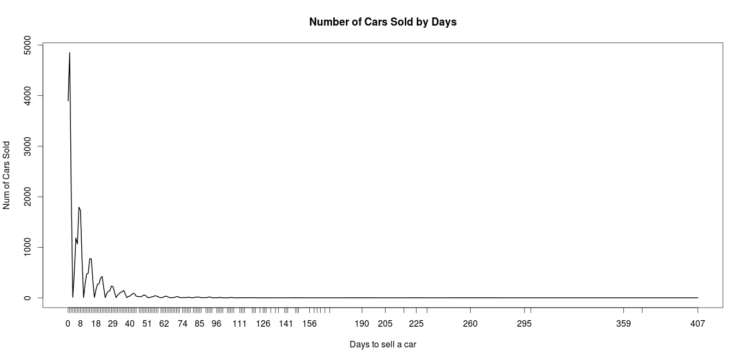
Plot car sold & not-sold by days
Most of the cars getting SOLD within a day, the value of Median = 0 also vouches that.

Slide 35
DMPRECOND
Description | Condition Grade BEFORE Electric Condition Report
Original Data Type | Numeric
DMPRECOND only available for SOLD cars. For Non-Sold cars it is 0, means not populated.
For SOLD cars, if pre cond is not done then DMPRECOND is 9.9

Slide 36
DMPOSTCOND
Description | Condition Grade AFTER Electric Condition Report
Original Data Type | Numeric
DMPOSTCOND only available for SOLD cars. For Non-Sold cars it is 0, means not populated.
For SOLD cars, if post cond is not done then DMPOSTCOND is 9.9

Slide 37
DMECRDATE
Description | Date of Electric Condition Report
Original Data Type | Integer
DMECRDATE is NON ZERO if either a PreCond or a PostCond is done.
DMECRDATE is ZERO if both Cond are not done.

Slide 38
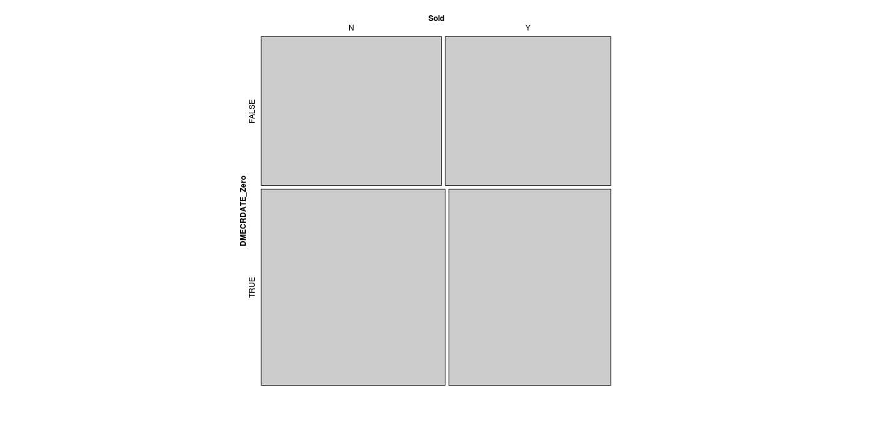
Conditional Distribution
Given DMECRDATE = 0 (i.e. NO ECR Report):
53.17 % of the cars are NOT SOLD
46.83 % of the cars are SOLD
Given DMECRDATE != 0 (i.e. ECR Report Done):
52.1 % of the cars are NOT Sold
47.9 % of the cars are SOLD
The distribution is almost same.

Slide 39
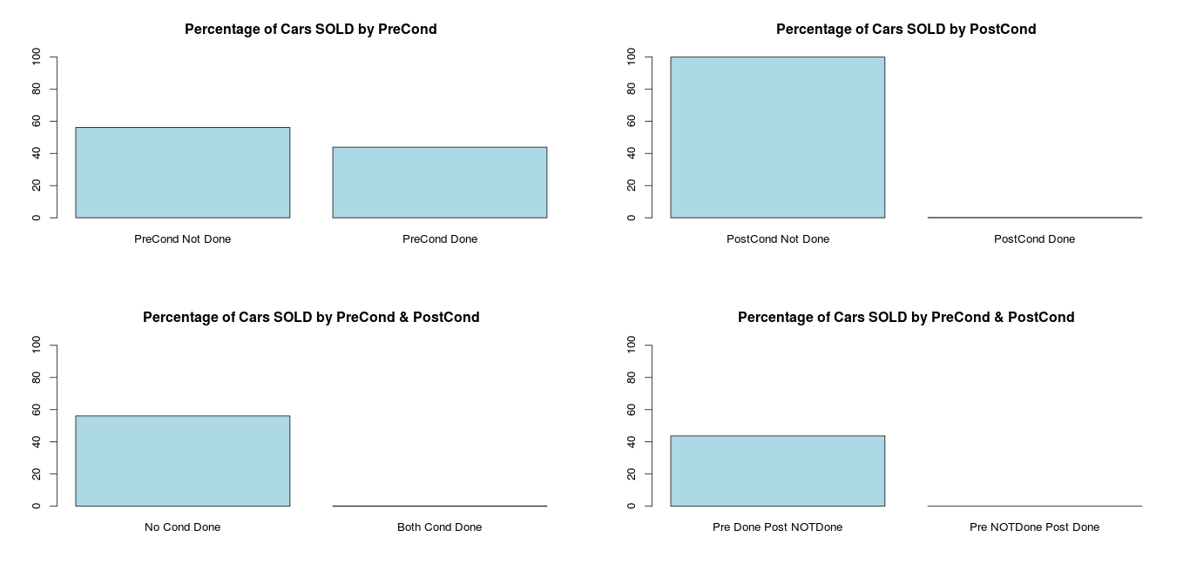
SOLD cars by Cond report
For SOLD group, PreCond done more than Post Cond.
Post Cond is very rarely done for the SOLD group.

Slide 40
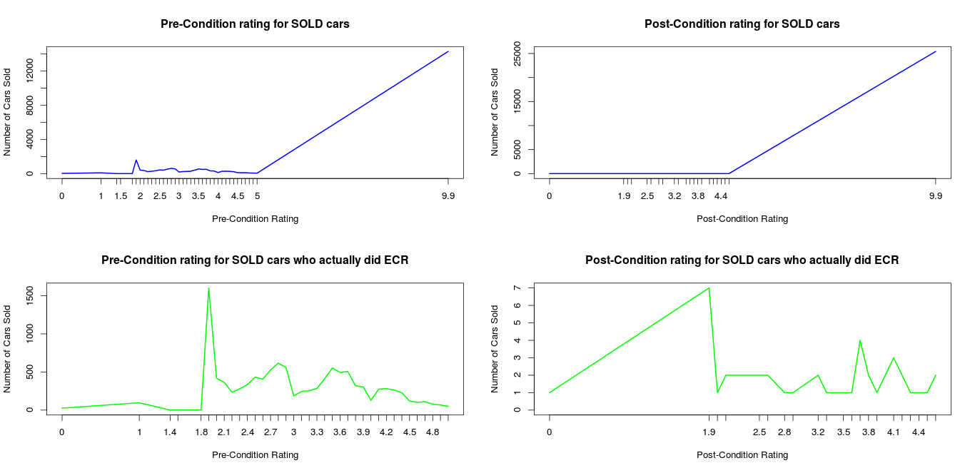
Plotting few more distributions

Slide 41
Pattern in the SOLD class
Most SOLD cars have not done Preconditioning, the most occurred rating is 9.9
Most SOLD cars have not done Postconditioning, the most occurred rating is 9.9
However, there are more Preconditioning than Postconditioning for the SOLD cars.
For the cars who did Preconditioning the most occurred ratings are b/w 2 and 4.
For the cars who did Postconditioning the most occurred ratings are b/w 3 and 4.5.

Slide 42
Three new variables created
Name | ECR
Description | Yes / No (factor) based on if the ECR report available or not respectively
Name | PreCond_B
Description | Yes / No (factor) based on if the Precond done or not respectively
Name | PostCond_B
Description | Yes / No (factor) based on if the Postcond done or not respectively

Slide 43
DMDETFEE, DMRECONFEE
Description | Vehicle Detailing Fee
Description | Vehicle Reconditioning Fee

Slide 44
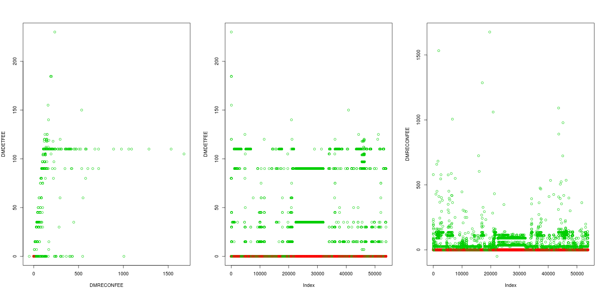
Distribution
All cars which were NOT SOLD did not have any DMRECONFEE & DMDETFEE (the RED dot at zero)
There are few cars which got SOLD but were not charged DMDETFEE (Vehicle Detailing Fee)
There are few cars which got SOLD but were not charged DMRECONFEE (Vehicle Reconditioning Fee)
Moreover DMRECONFEE is on an average more than DMDETFEE

Slide 45
X..Arbitration
Description | For each seller, % Arbitration = # arbitrated vehicles / total sold vehicles (at Manheim in 12 months)
Original Data Type | Factor
New Column | X..Arbitration_P
New Date Type | Integer (updated the “NA” values to -1)

Slide 46
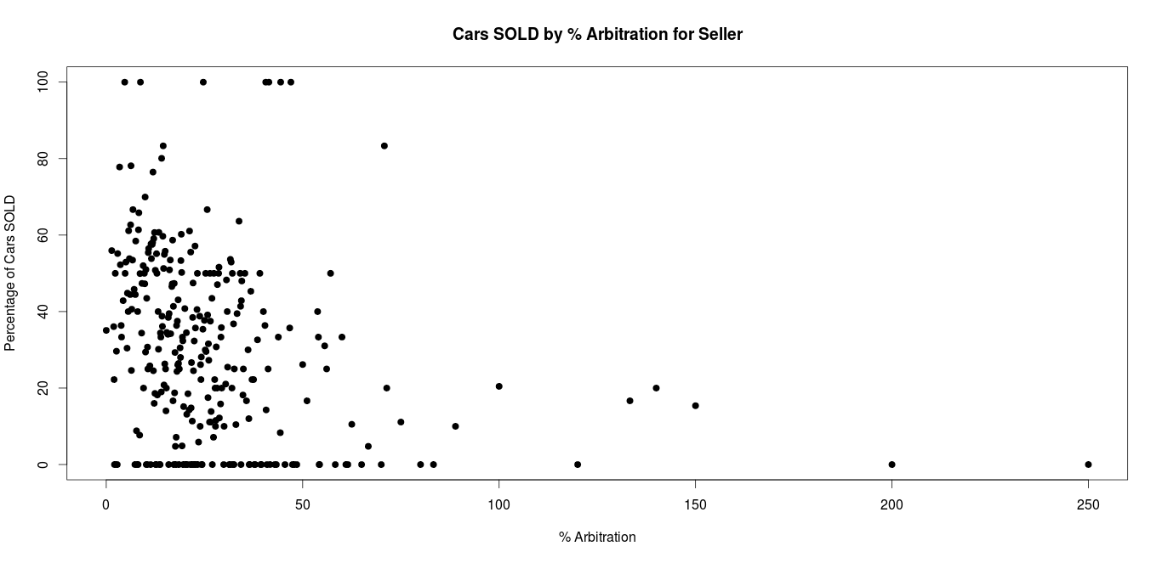
Plotting
Most of the cars SOLD have lower % Arbitration rate.

Slide 47
Fitting Statistical Models

Slide 48
Final Data Frame used
Predictors : DMMONTH , DMSALWK , SSALE_, SLANE_, SRUN_ , STIMES_H, SFLOOR , Floor_VNMMR, ModelYear_P, DMMODELYR, SMILES, DMJDCAT, AGEDDAYS, X..Arbitration_P, PreCond_B, PostCond_B & ECR
Response : DMSOLD (0 / 1) , 0 means No and 1 means Yes.
Setting Train and Test regimen on the dataset using 50% of the random samples each.
Methods : Ensemble methods to solve this Classification Problem using the following algorithms
Tree , Bagging , Random Forest and Gradient Boosting.

Slide 49
Algorithm 1 : Classification Tree
Variables Used in Tree Construction | AGEDDAYS , STIMES_H, ECR, PreCond_B
Number of terminal nodes | 8
Misclassification error rate | 11.33 %

Slide 50
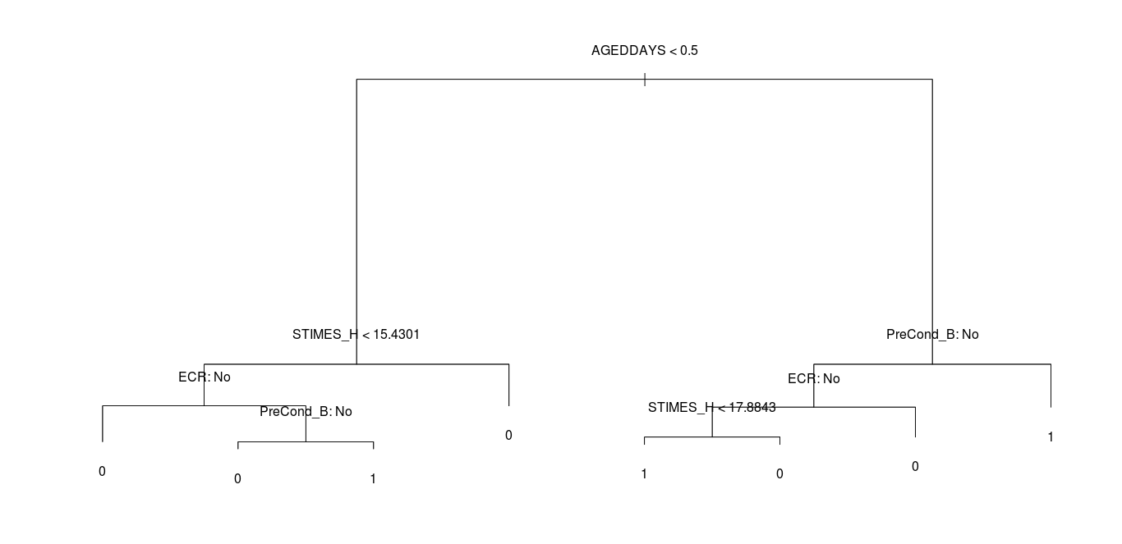
Classification Tree plot

Slide 51
Algorithm 2 : Bagging
Number of Trees | 500
Misclassification error rate | 9.19 %
Mean decrease in accuracy : how much inclusion of this predictor in the model reduces classification error.
A low Gini (i.e. higher decrease in Gini) means that a particular predictor variable plays a greater role in partitioning the data into the defined classes.
Illustrated on the next page.

Slide 52
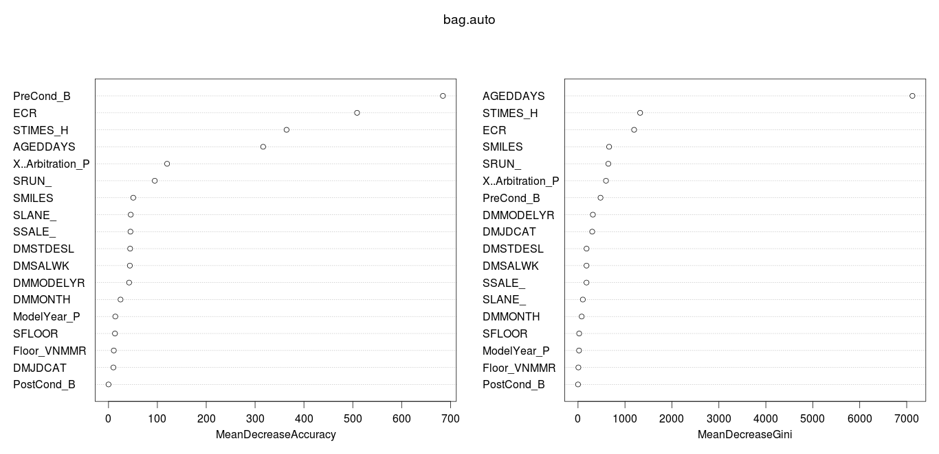
Importance plot (Bagging)

Slide 53
Algorithm 3 : Random Forest
No. of variables tried at each split | 5 (to decorrelate the variables)
Number of Trees | 500
Misclassification error rate | 8.71 %

Slide 54
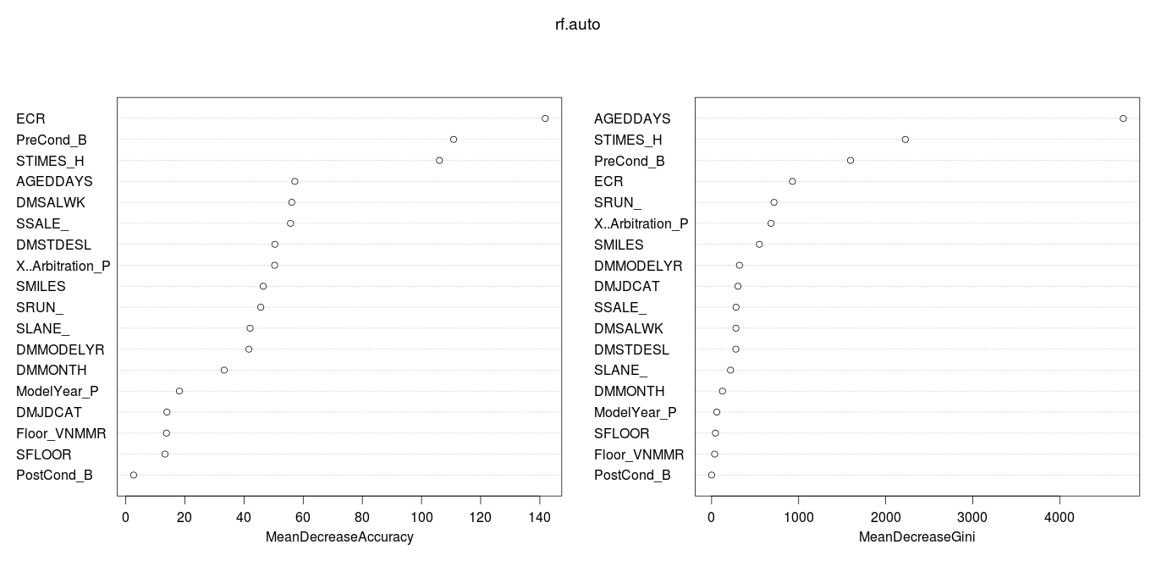
Importance plot (Random Forest)

Slide 55
Algorithm 3 : Gradient Boosting
Loss Function | Adaboost loss function
Number of Trees | 5000
Interaction Depth | 1 (i.e. Additive Model)
Relative Influence
AGEDDAYS : 97.94729983 %
STIMES_H : 2.03307580 %
ECR : 0.01962437 %
This has 0 % test misclassification error rate.

Slide 56
Relative Importance Plot
Loss Function | Adaboost loss function
Number of Trees | 5000
Interaction Depth | 4 (Interaction terms added)
Relative Influence
AGEDDAYS : 84.097232917 %
ECR : 6.355445918 %
STIMES_H : 5.119030716 %
PreCond_B : 4.341981076 %
X..Arbitration_P : 0.078079735 %
SRUN_ : 0.008229637 %
This has 0 % test misclassification error rate.

Slide 57
Conclusion

Slide 58
Hypothesis - 1 & Priority - 1
Less chance to sell a car towards end of a long sale (AGEDDAYS)
Inference :
84.1 % relative importance
Median = 0
Most of the cars getting
SOLD within a day
OPINION : TRUE

Slide 59
Hypothesis - 2 & Priority - 2
Having condition report helps to sell the car.
Inference :
Predictors ECR (either Condition report i.e. PreCond or PostCond or Both) and PreCond_B (PreCond is done) together have relative influence of 10.7 %
Most cars have not put the Condition Report.
From Treeplot PreCond report directly leads to the SOLD class.
PostCond is very rarely done.
PreCond is more effective, when the rating is more than 2.
OPINION : MODERATE TRUE

Slide 60
Hypothesis - 3 & Priority - 3
To sell your car, you need to get a better run numbers.
Inference :
Predictor STIMES_H has relative importance of 5.11 %
From the Tree plot, both for Long and Short period of sale, low Run numbers contribute for SOLD cars. For Short period sale Run Times less than 15hrs is preferable. For Long period sale Run Times less than 18 hrs is preferable.
Cars which get SOLD will have fewer runs as they will be sold faster, hence less Run times.
OPINION : FALSE

Slide 61
Hypothesis - 4 & Priority - 4
Bad seller reputation has negative impact to seller’s conversion rate.
Inference :
Predictor X..Arbitration_P has relative importance of 0.07 %
Most of the cars SOLD have lower % Arbitration rate.
OPINION : TRUE

Slide 62
Hypothesis - 5 & Priority - 5
Setting a floor price helps selling a car.
Inference :
When a seller doesn't provide a floor value then there is almost an equal distribution between SOLD and NOT SOLD classes. Reason might be there is a less friction between the Buyer and Seller transactions.
When a seller provides a floor value then the distribution between both the classes are not equal.
When FLOOR > VNMMR, more number of NOT SOLD.
When FLOOR price was not consulted with VNMMR then more NOT SOLD.

Slide 63
Floor price ...
OPINION : CONDITIONAL
Neutral : When Floor Price is not set.
False : If VNMMR price is not consulted or setting Floor Price higher than the VNMMR price.

Slide 64
Hypothesis - 6 & Priority - 6
Older model year cars are not selling well than newer model year cars.
Inference:
Percentage distribution of cars getting SOLD by Model year is very random and inconclusive.
Binnig it shows that there is no difference based on the Model year of the car.
OPINION : FALSE

Slide 65
Reference
The source code was written in R 3.1.3.

Slide 66
Thank You

